Slide 1
Presentation Project
Bjorn Jorissen
William Thenaers

Slide 2
Our Idea
Complex rules ➔ use technology
Monopoly has rules that are often overlooked
Framework ➔ boardgames with linear pathway
Using RFID tags & LIDAR
Notes:
Embed a boardgame with somewhat complex rules with technology to decrease the knowledge needed to play this game.
We used monopoly as an example, we played it feature complete once and there are a lot of rules that regular players never use while playing with the physical boardgame but these rules make the game more interesting.
Our goal was to make a framework that can be used in all boardgames with a similar style. Right now it could be used with all boardgames which have a linear pathway and the design we have right now can be used for all boardgames with 40 squares.
This framework would combine RFID tags to determine which piece had moved and LIDAR to determine where it moved to. This idea changed during our research and experiments.

Slide 3
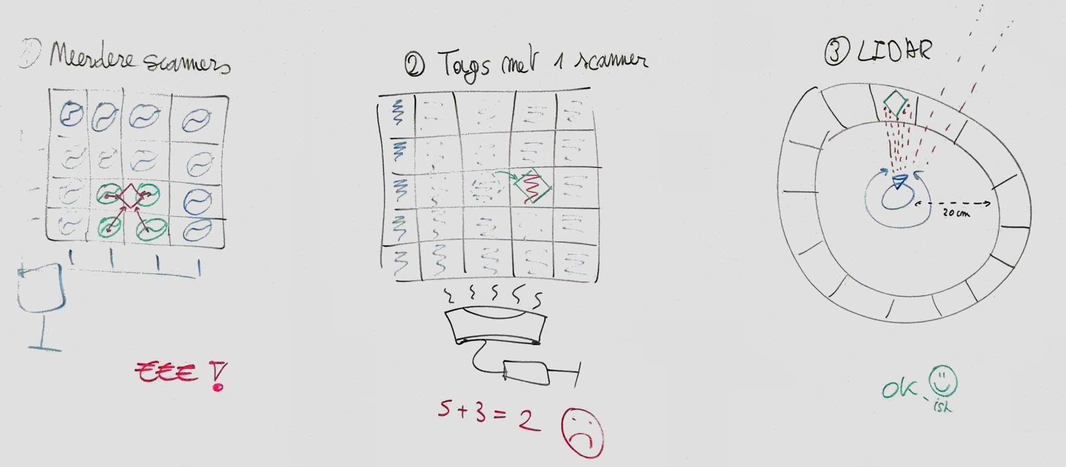
Notes:
We started with a few idea's…

Slide 4
Idea: multiple scanners
Feedback: to expensive
Every scanner ➔ an Arduino
Simultaneous RFID reader available
Notes:
Our first idea was to work with multiple scanners and RFID tags on every piece of the board game. With this we could make an triangular calculation with the signal strength of each RFID tag to determine the location.
In the feedback for this idea we understood that you would need an Arduino with a reader for every single scanner which would turn out to be way too expensive.
Then you also said that a simultaneous RFID reader is available here at EDM. This reader should be able to read multiple tags at once which we were going to test out next.

Slide 5
Idea: RFID grid with signal blockers as pieces
Test the available simultaneous RFID reader
Notes:
Our idea for this usage of RFID was that we would create a grid of RFID tags and attach a signal blocker to each piece. With this information we could then know which positions of the board are blocked and thus where the pieces are standing. For this to work we need a reliable read, which we tested next.
So the next thing we did was test the available RFID reader that could read multiple tags simultaneously, according to the spec sheets this reader is able to read 100 tags at once.

Slide 6
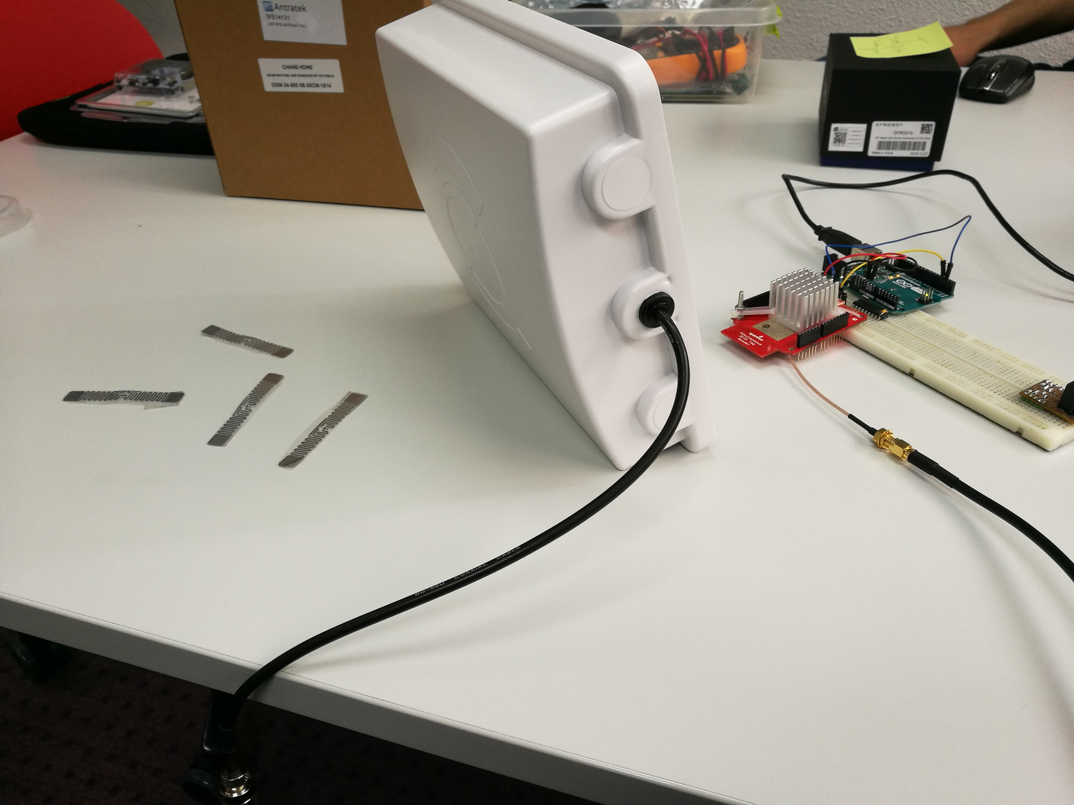
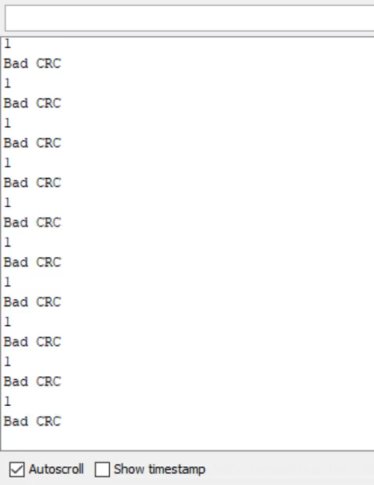
Notes:
So we tried it and even with a very simple setup like this you get results like these. Bad CRC shows that the received signal is not reliable enough to ensure a correct received value.
Like you can see most of the time only 2 different tags are detected, with the addition of tags in front of the reader this doesn’t increase, it makes it even worst.
I tried just ignoring the bad signal and just taking the unique epc values but with this I got up to 10+ different epc values in a matter of seconds and stopped this immediately.

Slide 7
Test the available simultaneous RFID reader
Way to unreliable for a simple setup
Interference of UHF tags and receivers
Power supply
Code iterations
In and out of range
Notes:
So this test resulted that the RFID reader is way to unreliable for even a simple setup so let alone a board filled with even more tags.
We did some research why this was the case because the reviews of the reader are good and a lot of people have shown a working example. The tags are Ultra-High Frequency tags, so these should avoid interference with other tags according to our research. These tags are specially made to not interfere with other tags.
During this research we saw that the examples people had shown mostly had an external power supply so we tried adding a power supply as well because we only used power over USB before this. But the results were not better than before we attached the power supply.
During the changes and research we also tried changing the code a few times and reading the tags differently like I said before with ignoring the bad CRC message. But this didn’t result in major changes, we made some improvements in readability so we better understood what was being read but that was all that gave better results. So most of our efforts were in vain.
We also noticed that the examples had completely different use cases which only required to read each tag once. In all use cases for RFID the tags are moving, like using RFID tags to track inventory items from a warehouse. So we tried putting the tags out of the scanners range and back in the scanners range. This resulted in always detecting the tags. Even just moving the tags in front of the scanner resulted in better output. An RFID tag draws energy from Radio Frequency waves, we think that if these stay stationary this energy may be insufficient for the RFID tag to sent a reliable and complete signal.

Slide 8
[Moving tags & output video]

Slide 9
Velodyne LIDAR
Notes:
While working on the RFID tags we also experimented with the LIDAR.

Slide 10
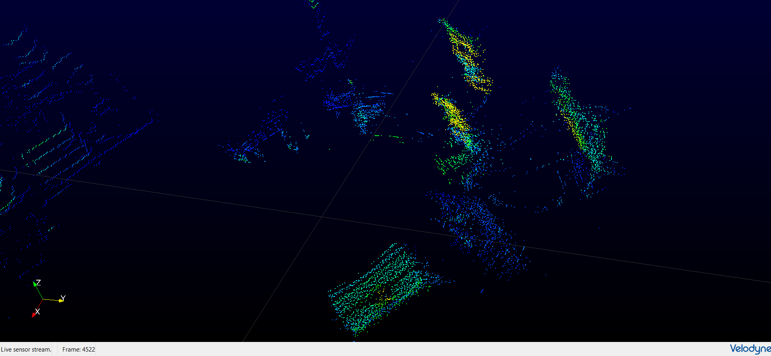
Maybe insert that video here, can’t find it though
Notes:
We started experimenting with the Velodyne LIDAR which was available from EDM but this was a LIDAR especially made for outdoors.

Slide 11

Velodyne LIDAR
0.9 meter > Range > 100 meter
Outdoors
RPLIDAR
20 centimeters > Range > 6 meter
Indoors
Notes:
The Velodyne LIDAR has a minimum range of 0.9 meters and a maximum range of 100 meters. This is good for outdoors, which the LIDAR is designed for, but not really for our idea. We could change our idea yes, but at this stage we still though to combine the RFID tags and the LIDAR on a single boardgame. So we looked into different LIDAR’s and found a cheaper developer edition with a minimum range of 20 centimeters. This one was ordered and delivered very quickly.

Slide 12
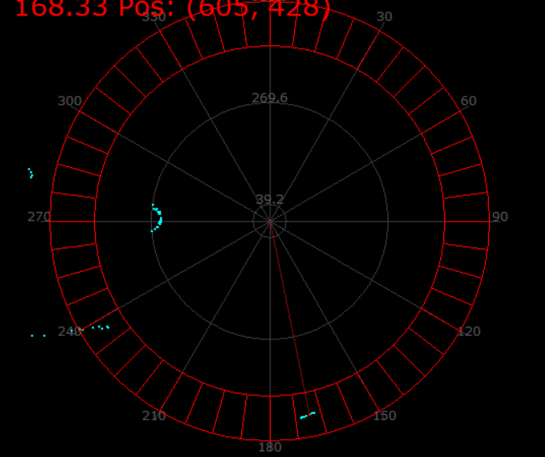
Amount of cells
Range of the cells
Determine which cells are occupied and sent this info
Calculate the traveled distance
Minimum range = 10 centimeters
Notes:
With the use of this LIDAR we made a program were you can set the amount of cells the boardgame has, the minimum range to the cells and the maximum range which is the distance from the LIDAR to the end of the cells. This can be calibrated in the game itself.
With this program we could determine which cells were occupied and pass this information to the game itself. From there we can then determine which cell position has moved (based on the previous received array) and how far is had moved.
We also noticed very quickly that the LIDAR had a minimum range of 10 centimeters instead of 20 centimeters.

Slide 13
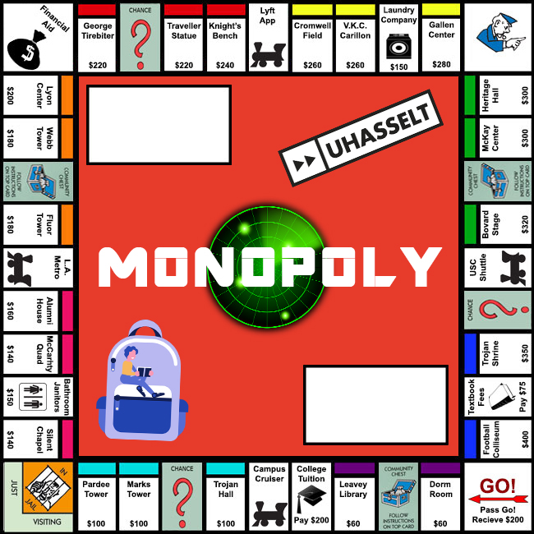
Not feature complete
Some of our additions
History
Visibility of pieces
Improvement in comfort
Visual changes
Bug fixes (lots of them)
Notes:
We then found and adjusted a open source monopoly game. It turns out that finding a feature complete monopoly game that is also open source is not that easy. Our original goal for using technology to make the complex features easier is not achieved by this example because only the simple features are implemented. To completely implement the game is kinda out of the scope of this project, the important part is using the LIDAR and plugging it into the game. If the game was feature complete we only needed to change the ‘rollDice’ function in order to make it work. Right now we even added a history function because we didn’t even knew what happened during a turn.

Slide 14
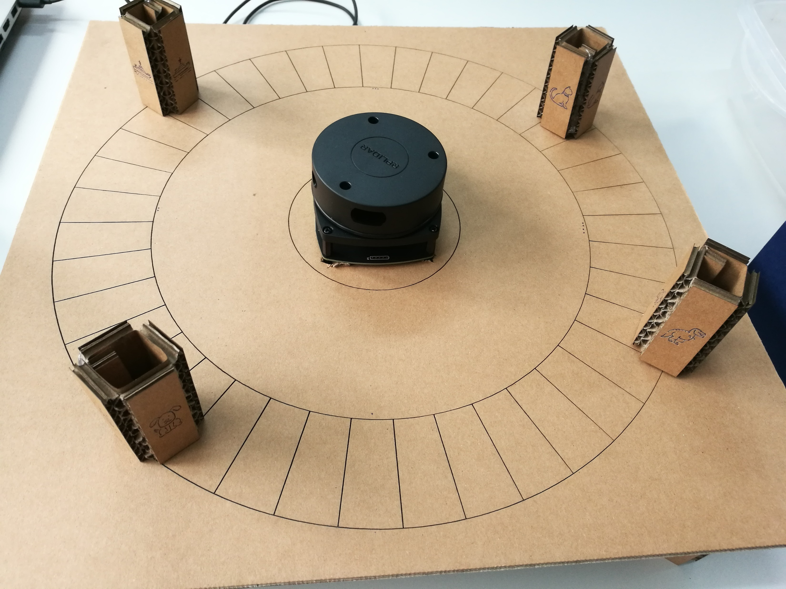
Notes:
This is our finished product which we will demo after this.
It’s made out of cardboard and is laser cut this way.

Slide 15
Future work
Multiplayer
Make the framework easier to plug-in
More games
Notes:
The next idea is to make the game multiplayer, this gives the option to play on a physical boardgame to people all over the world. The difficulty here would be checking if the player is not cheating, right now you could easily set your piece wherever you want and then the game will just assume your new position as your actual position.
At the moment it’s not hard to plug the software we created for the lidar in any boardgame because all you need to do is set some parameters according to the board you printed or drew. We could make this process even easier by creating the communication through COM ports or something similar. Right now we implemented the sdk and other stuff needed to operate the LIDAR into the game code itself.
Because of the way the design if right now we could easily make more games using the exact same setup (or only changing the board itself) therefore adding more games would be a good thing to do.

